Slide 1
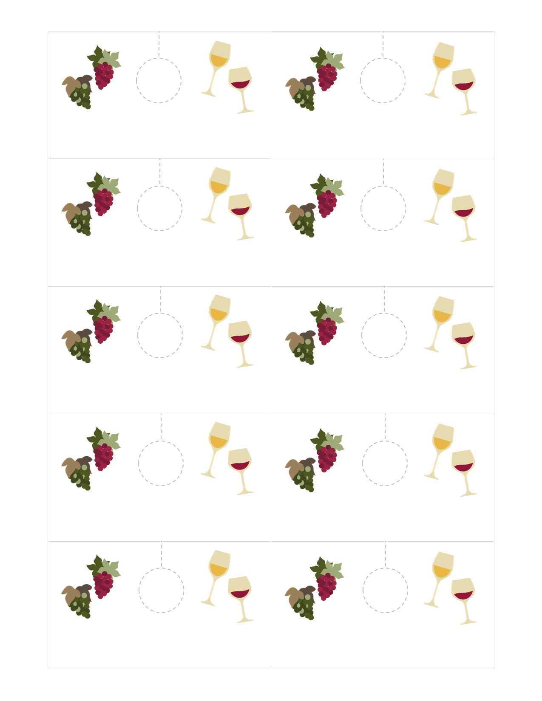
All wording and numbers are editable. Change the fonts or number sequence to your liking:
[name]
[name]
1 2 3 4 5 6 7 8 9 10
1 2 3 4 5 6 7 8 9 10
[name]
[name]
1 2 3 4 5 6 7 8 9 10
1 2 3 4 5 6 7 8 9 10
[name]
[name]
1 2 3 4 5 6 7 8 9 10
1 2 3 4 5 6 7 8 9 10
[name]
[name]
1 2 3 4 5 6 7 8 9 10
1 2 3 4 5 6 7 8 9 10
[name]
[name]
1 2 3 4 5 6 7 8 9 10
1 2 3 4 5 6 7 8 9 10

Slide 2
Printing and using these wine-tags:
Type in the name of your guests in the [name] part
Re-number the tags if you are using more or less bottles for your event
Print using good quality card stock
Cut labels out carefully*
Use a ¾ size circle punch to make a hole where indicated and cut on the dotted line
Place tags on stem of each wine glass
*These tags are formatted so that you can use a plain white business card template. I use these from Amazon. They have a clean edge and I don’t have to worry about cutting them out myself. Bonus!
Credits:
Clipart found in this document is by revidevi
Thank you for downloading this product!
Please visit my blog to learn more about what I love to do!

